Slide 1

Simulating fracture in anisotropic materials containing impurities
Avirup Mandal, Parag Chaudhuri, Subhasis Chaudhuri
Indian Institute of technology bombay

Slide 2
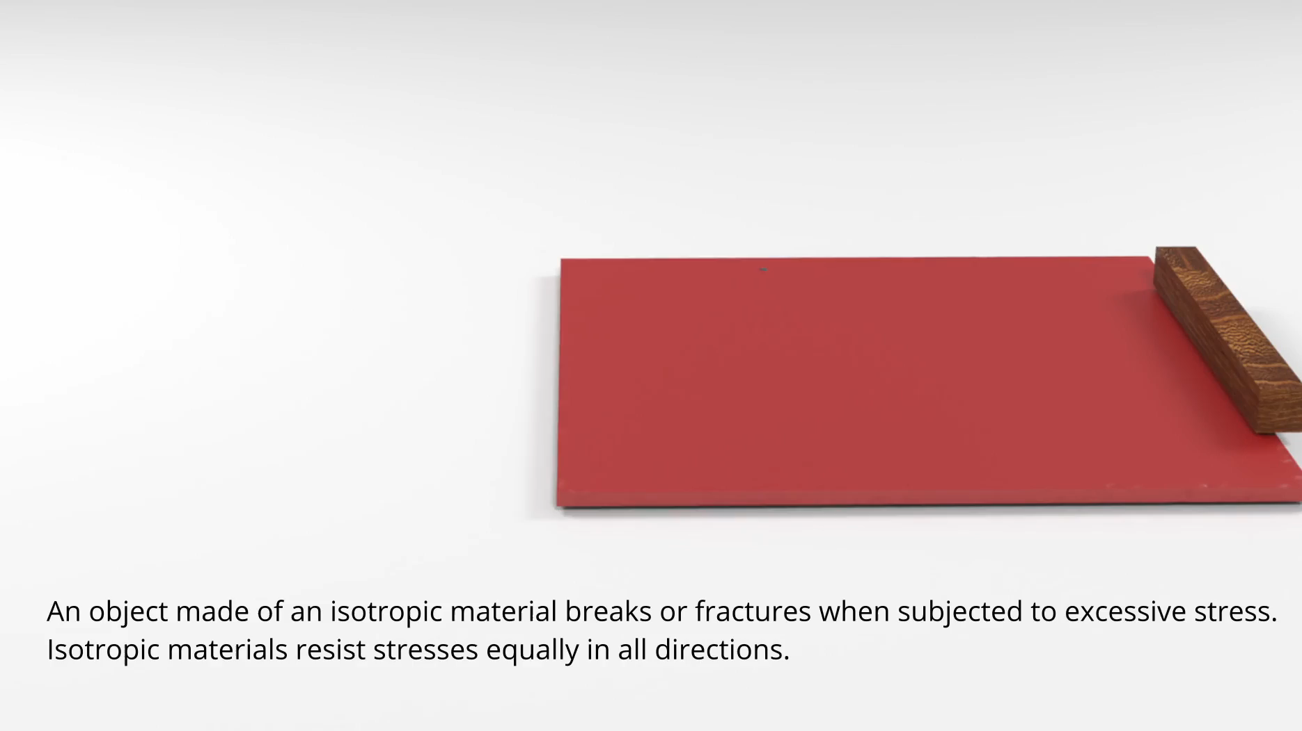
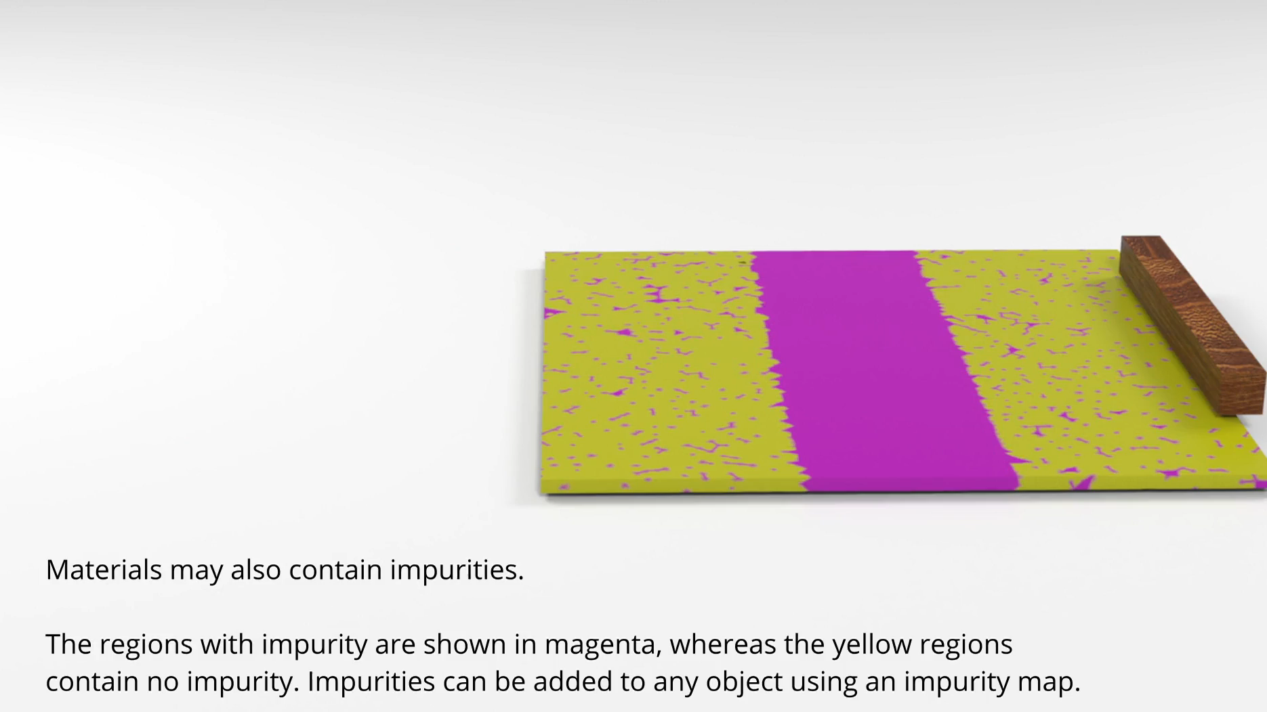
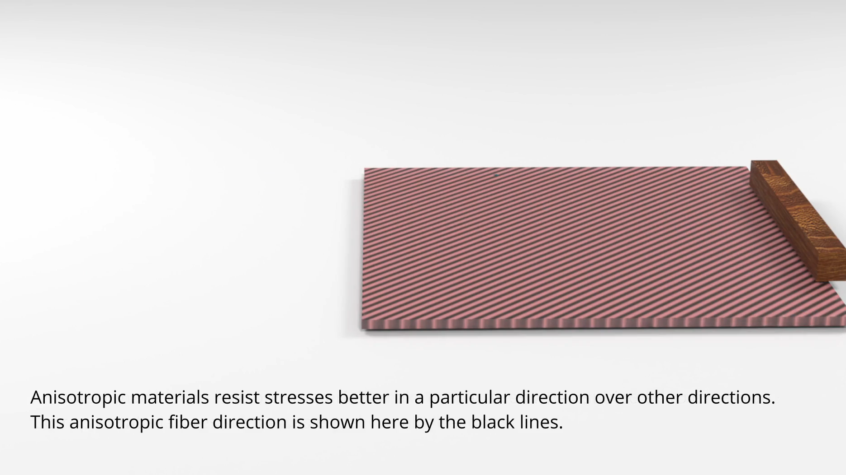
Motivation
Material property and environmental effects alter their fracture pattern significantly.
Anisotropy makes object stiffer in preferred directions.
Impurity affects the material integrity.

Slide 3
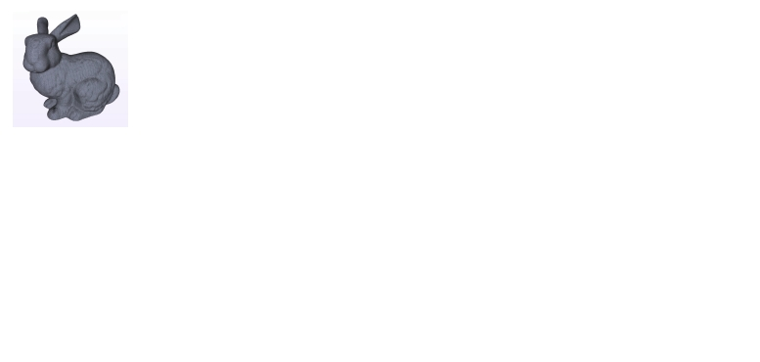
Graph-based FEM
Given an object

Slide 4

Graph-based FEM
Given an object, represented as a volumetric mesh with tetrahedral elements

Slide 5
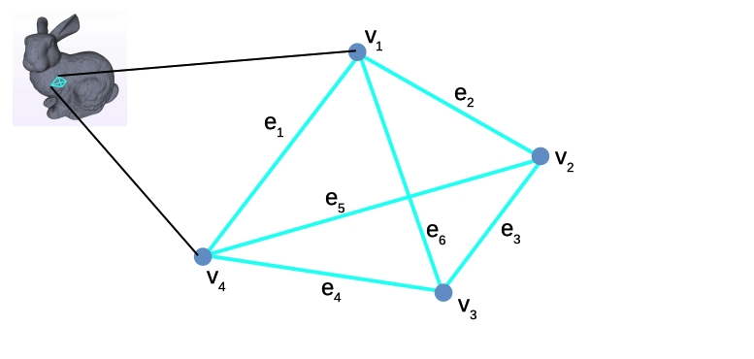
Graph-based FEM
…we use the graph induced by the edges of the finite elements, between the vertices, for our FEM computations.

Slide 6
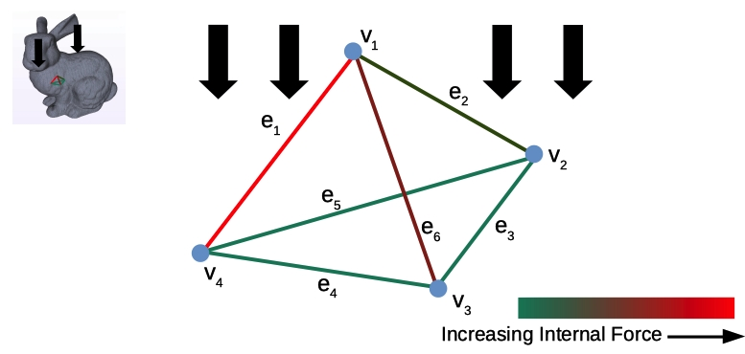
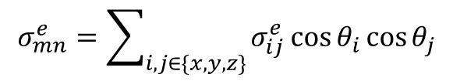
Graph-based FEM
$$σ_{mn}^{e}=\sum_{i,j∈\{x,y,z\}}{σ_{ij}^{e}}\cos{θ_{i}}\cos{θ_{j}}$$
External load cause internal stress, which are resolved along edges of the graph.

Slide 7
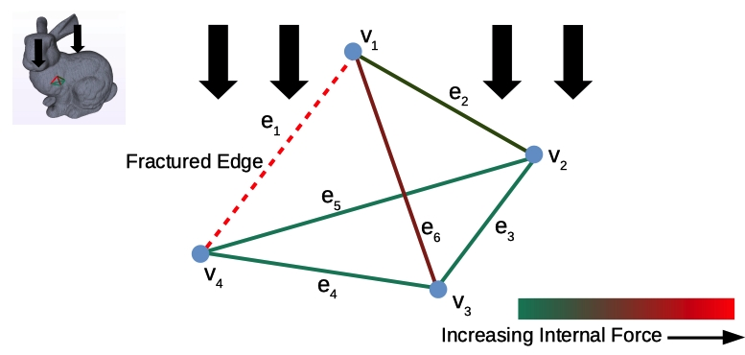
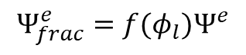
Graph-based FEM
$$Ψ_{frac}^{e}=f(φ_{l})Ψ^{e}$$
When stress in an edge exceeds a critical threshold, it is labeled as fractured and the internal energy of the system is reformulated, without any remeshing.

Slide 8
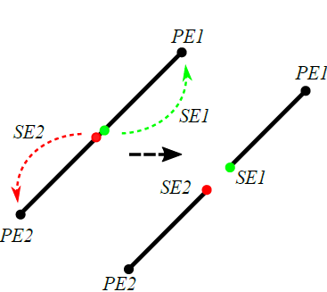
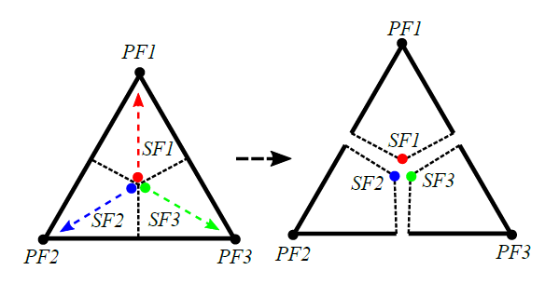
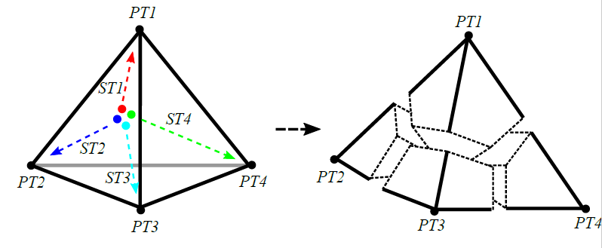
visualization
Surface remeshing
The outer surface is re-meshed only for visualization.
Split edge, triangle and tetrahedron into two, three and four segments.
Child nodes follow the parent nodes.

Slide 9
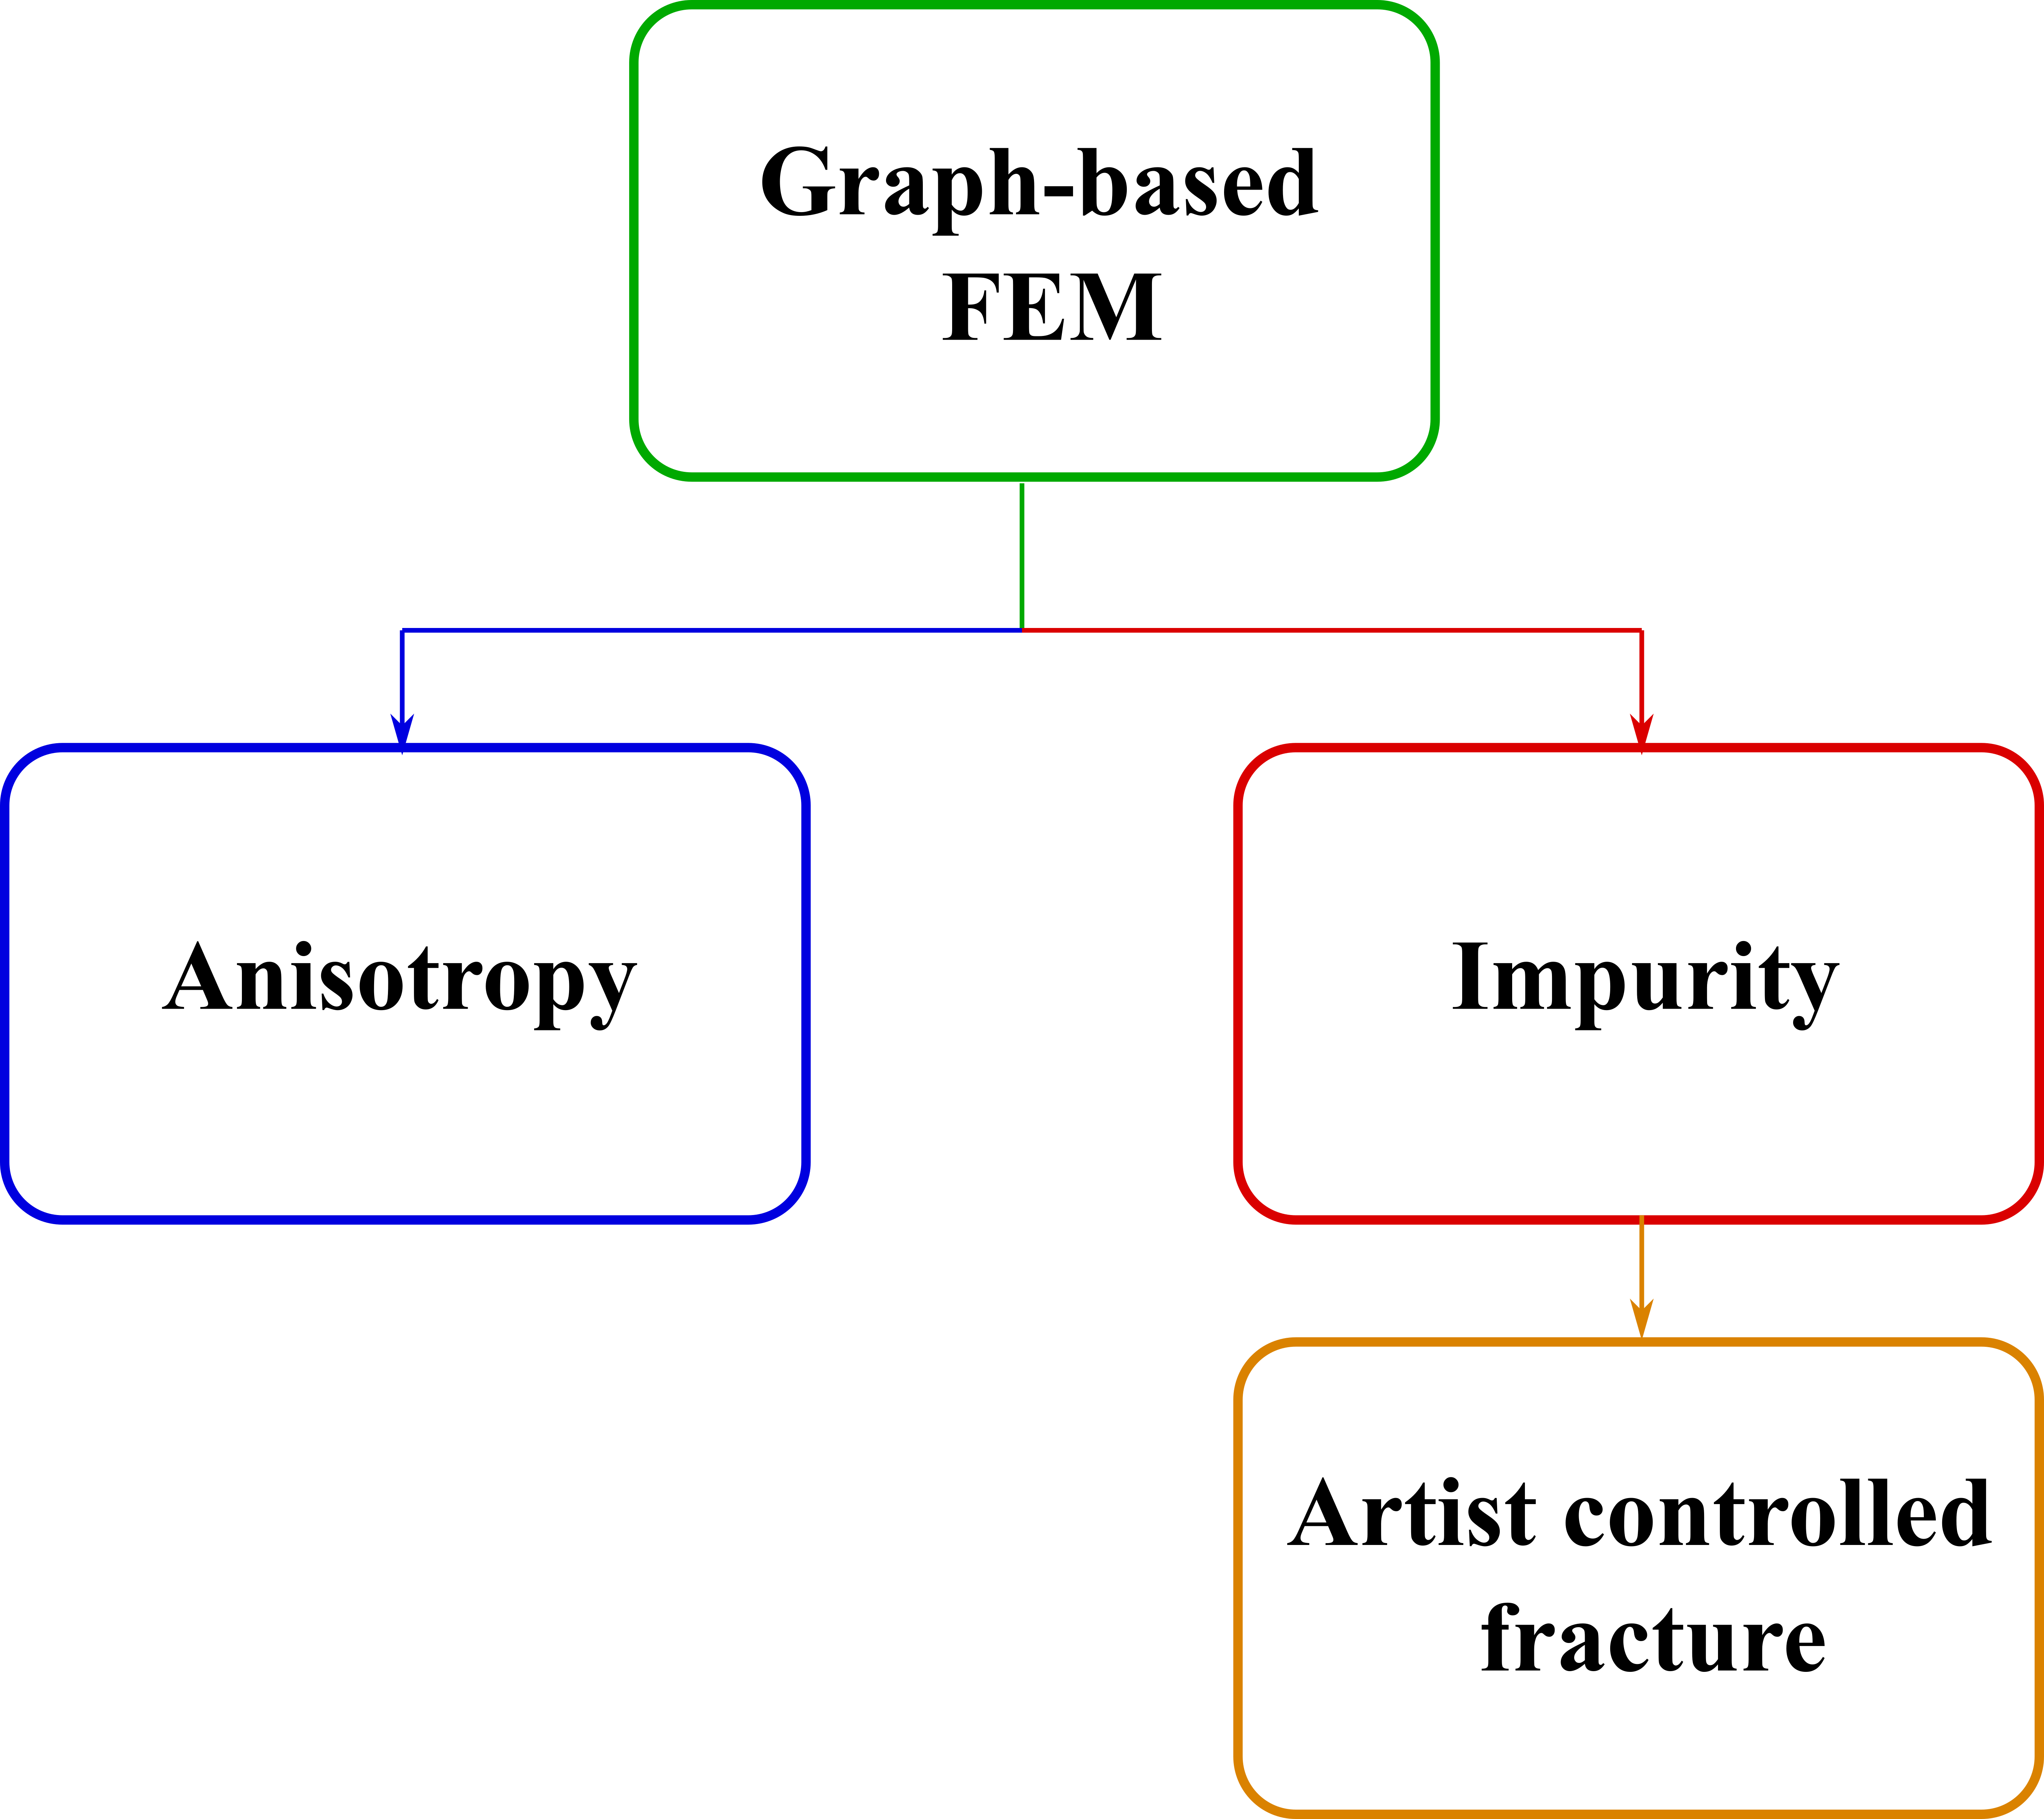
Anisotropy & impurity in graph-based FEM
Building on graph-based FEM, we simulate effect of anisotropy on fracture.
Simulated fracture of impure material in graph-based FEM framework with random graph.
Using the random graph technique we modelled artist directed fracture patterns.

Slide 10
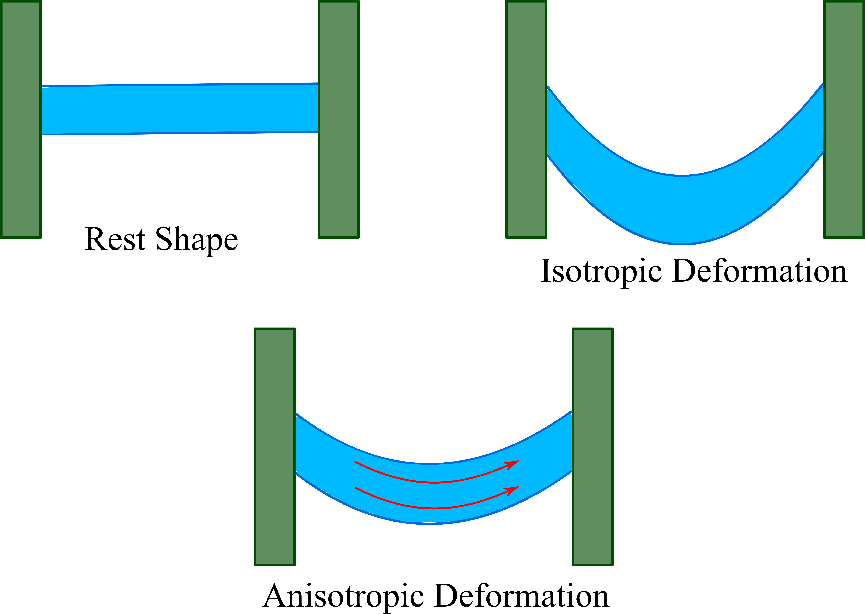
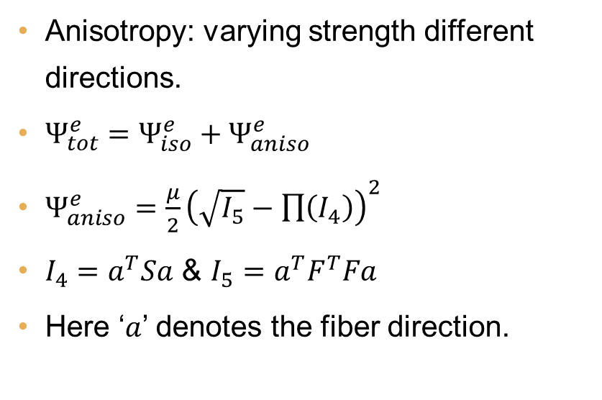
anisotropy
Inversion-free energy
Anisotropy: varying strength different directions.
$Ψ_{tot}^{e}=Ψ_{iso}^{e}+Ψ_{aniso}^{e}$
$Ψ_{aniso}^{e}=\frac{μ}{2}{\left(\sqrt{I_{5}}−\prod{\left(I_{4}\right)}\right)}^{2}$
$I_{4}=a^{T}Sa$ & $I_{5}=a^{T}F^{T}Fa$
Here ‘$a$’ denotes the fiber direction.

Slide 11
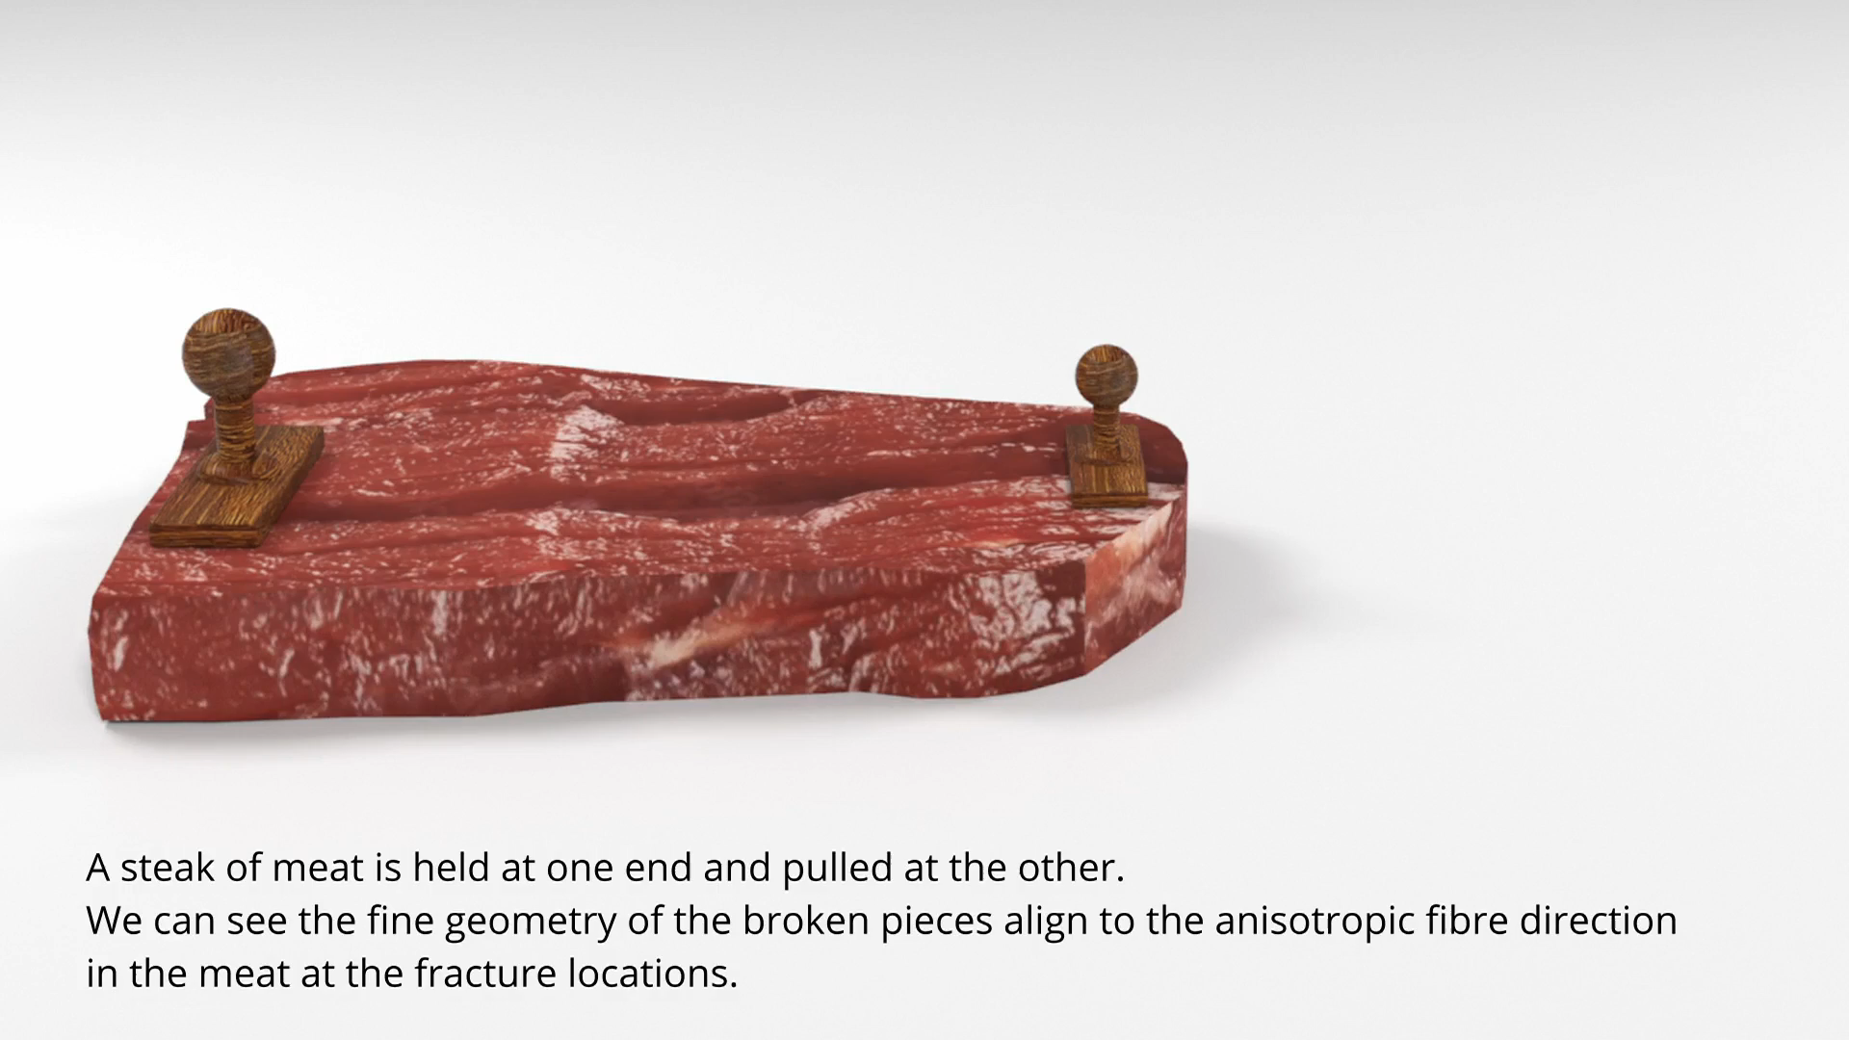
Aniso Meat

Slide 12
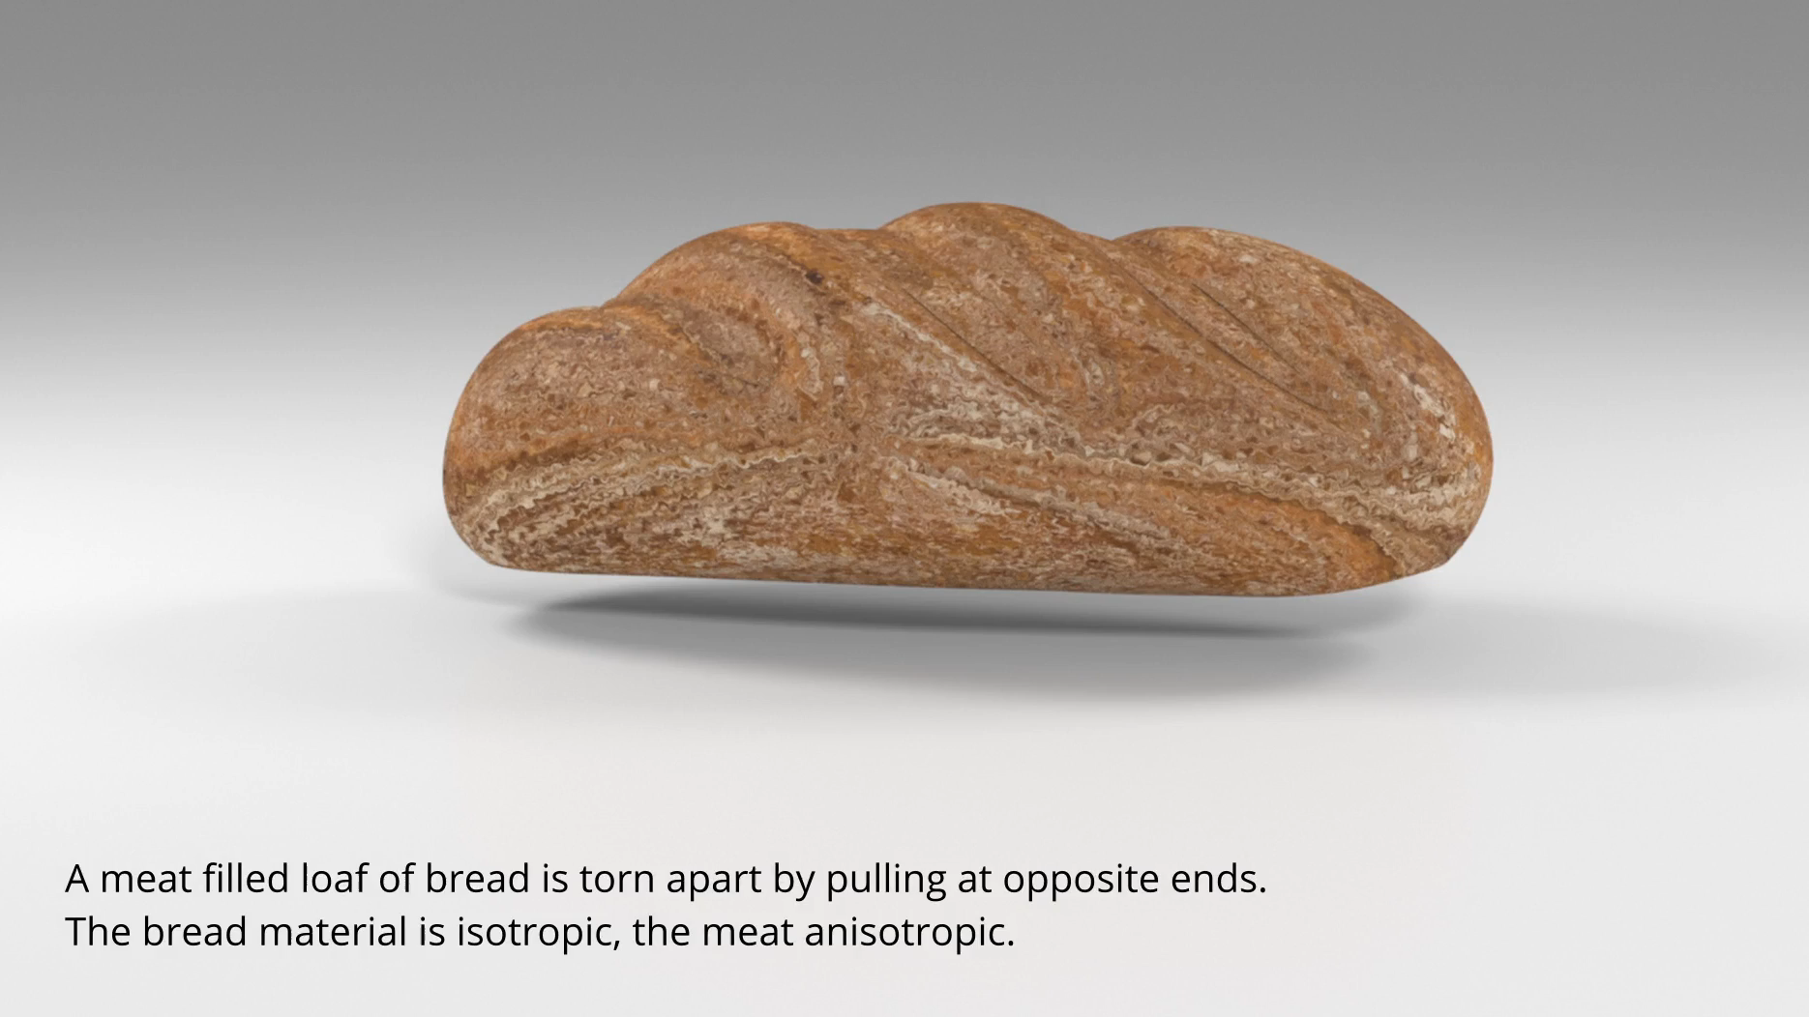
Aniso Meat and iso loaf

Slide 13
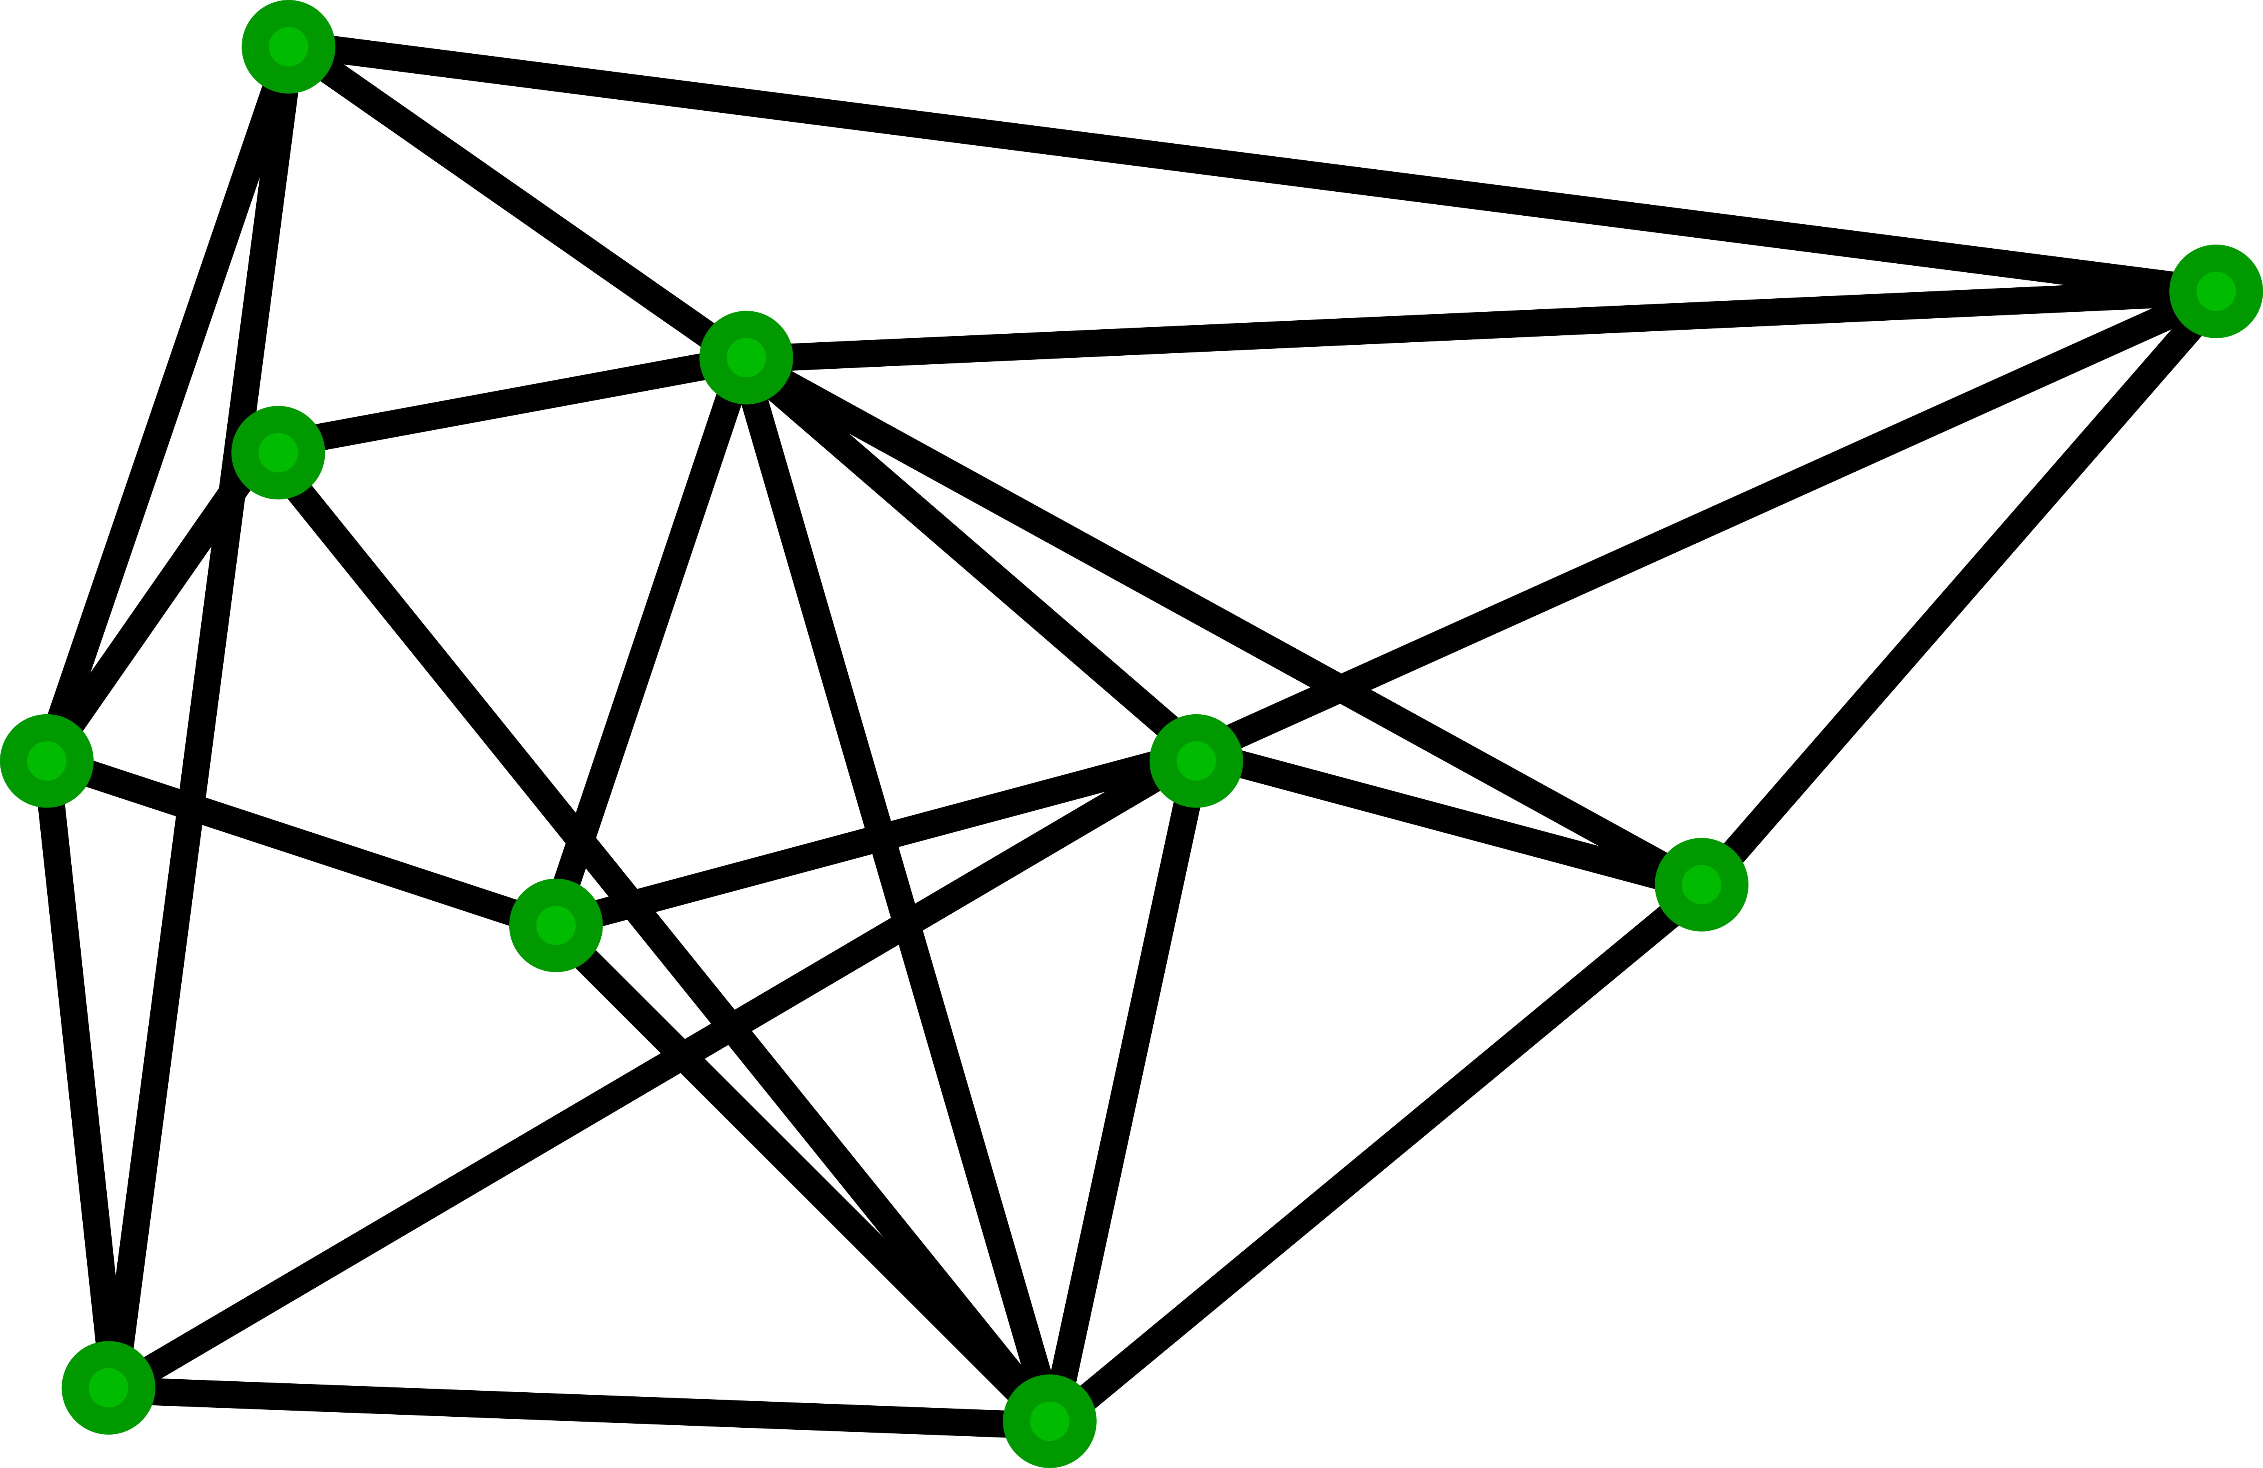
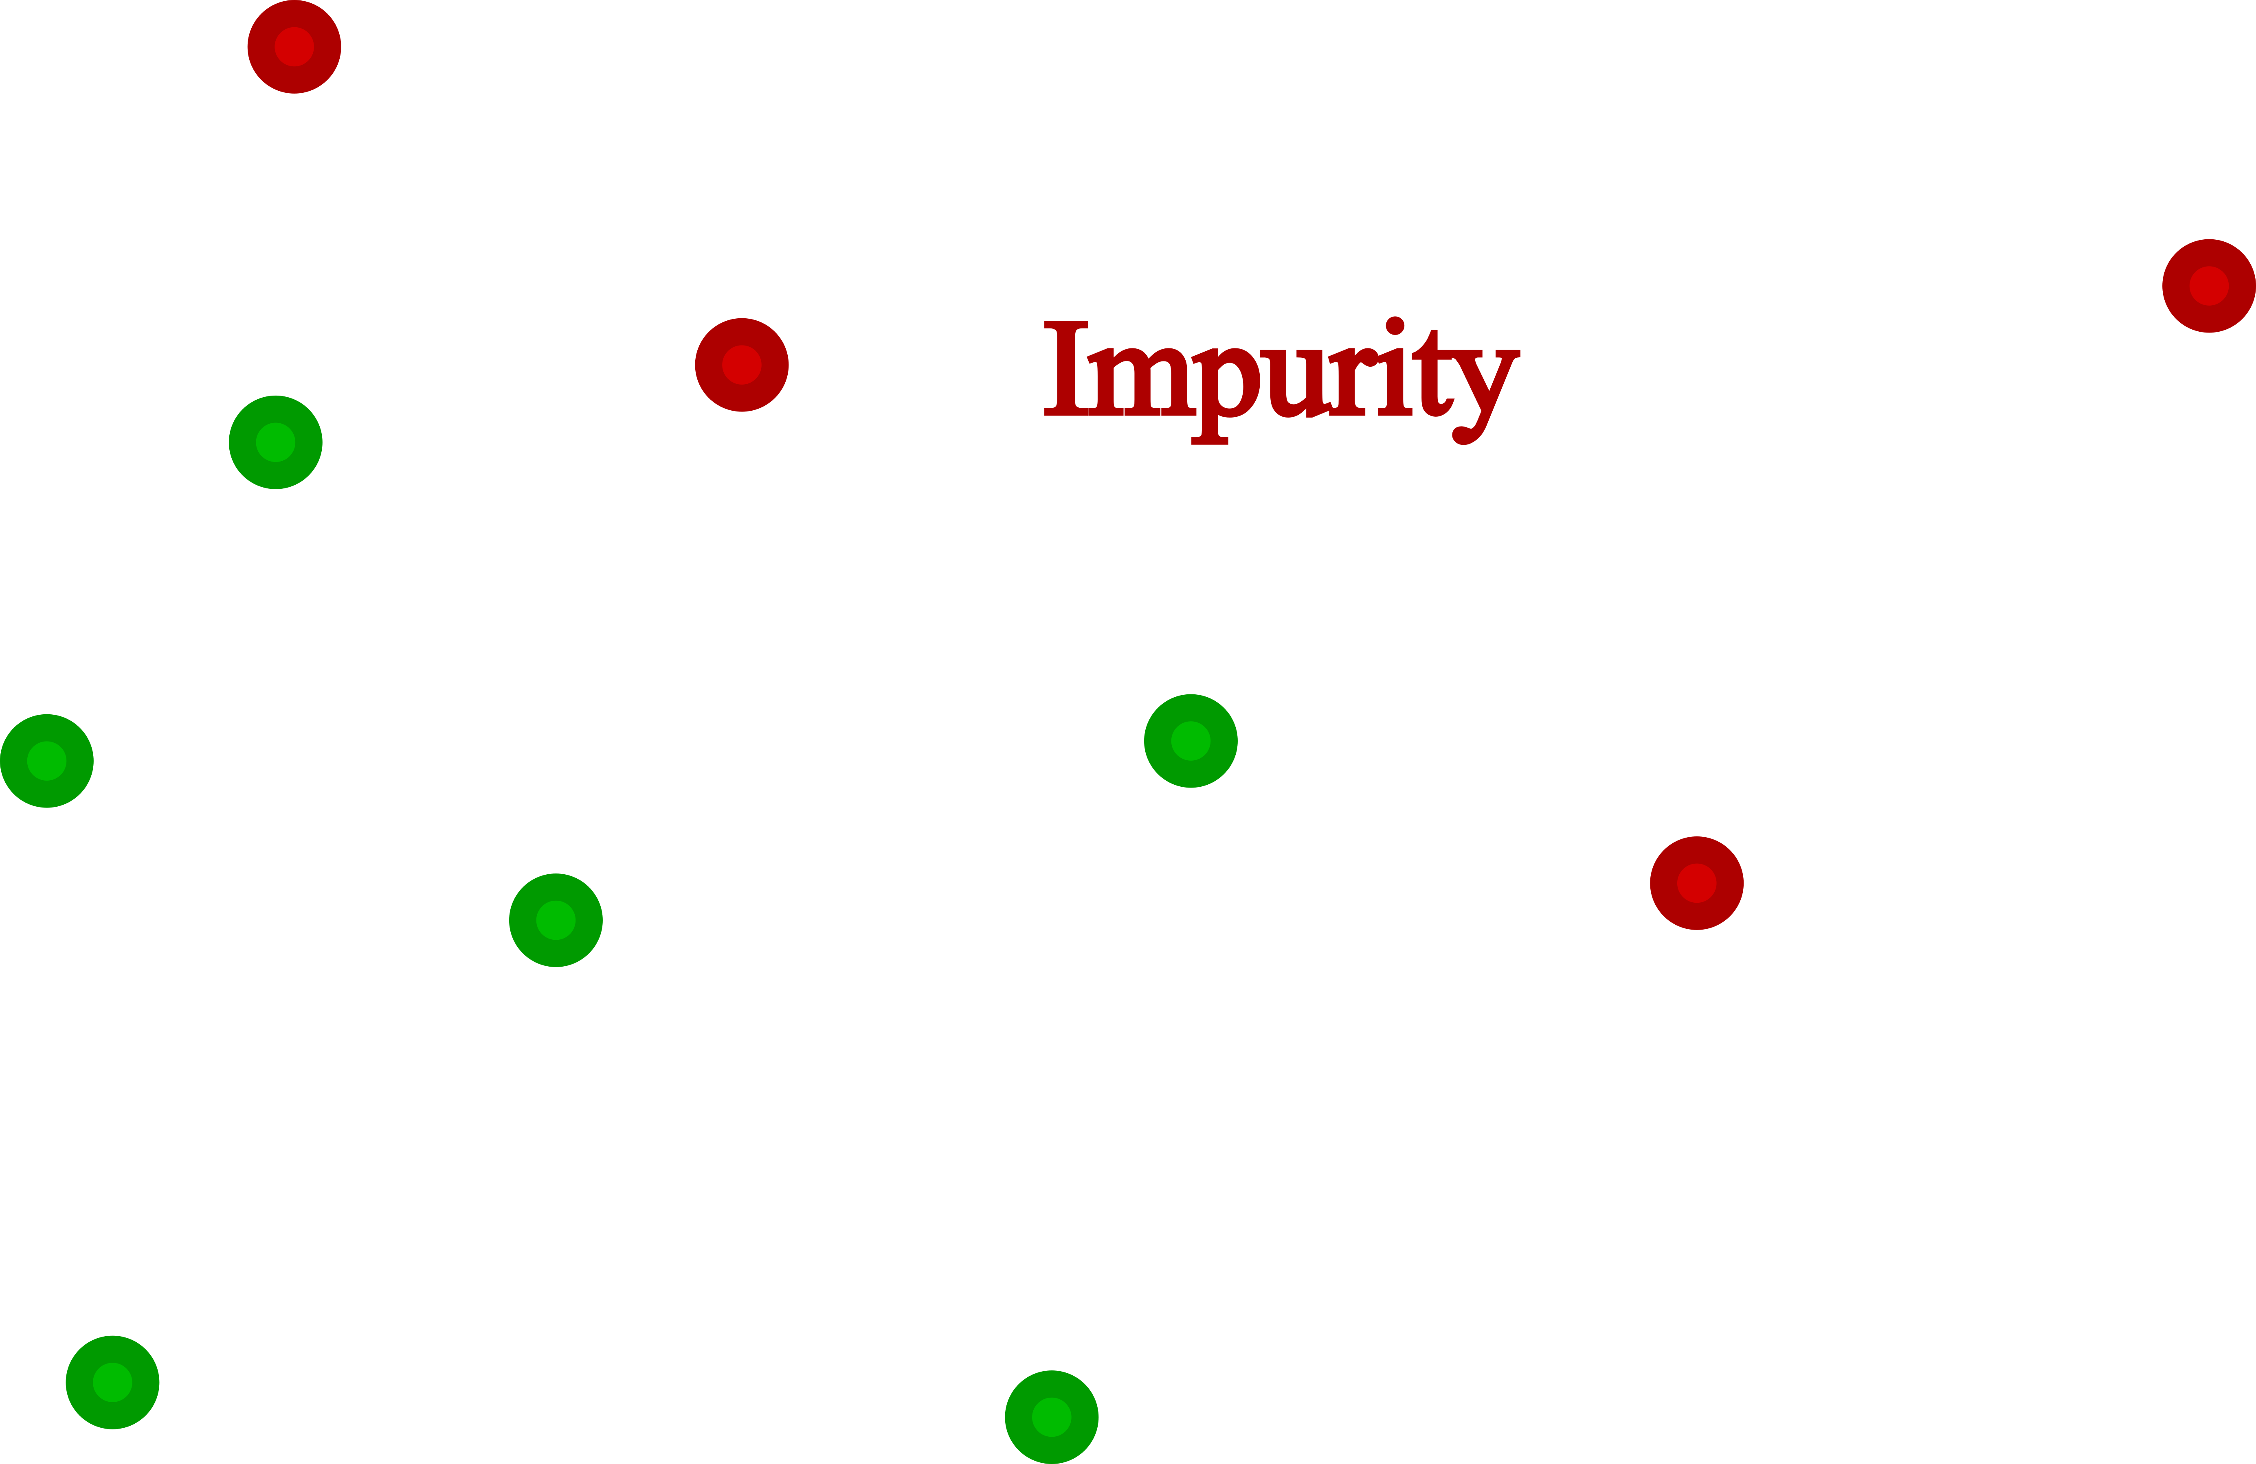
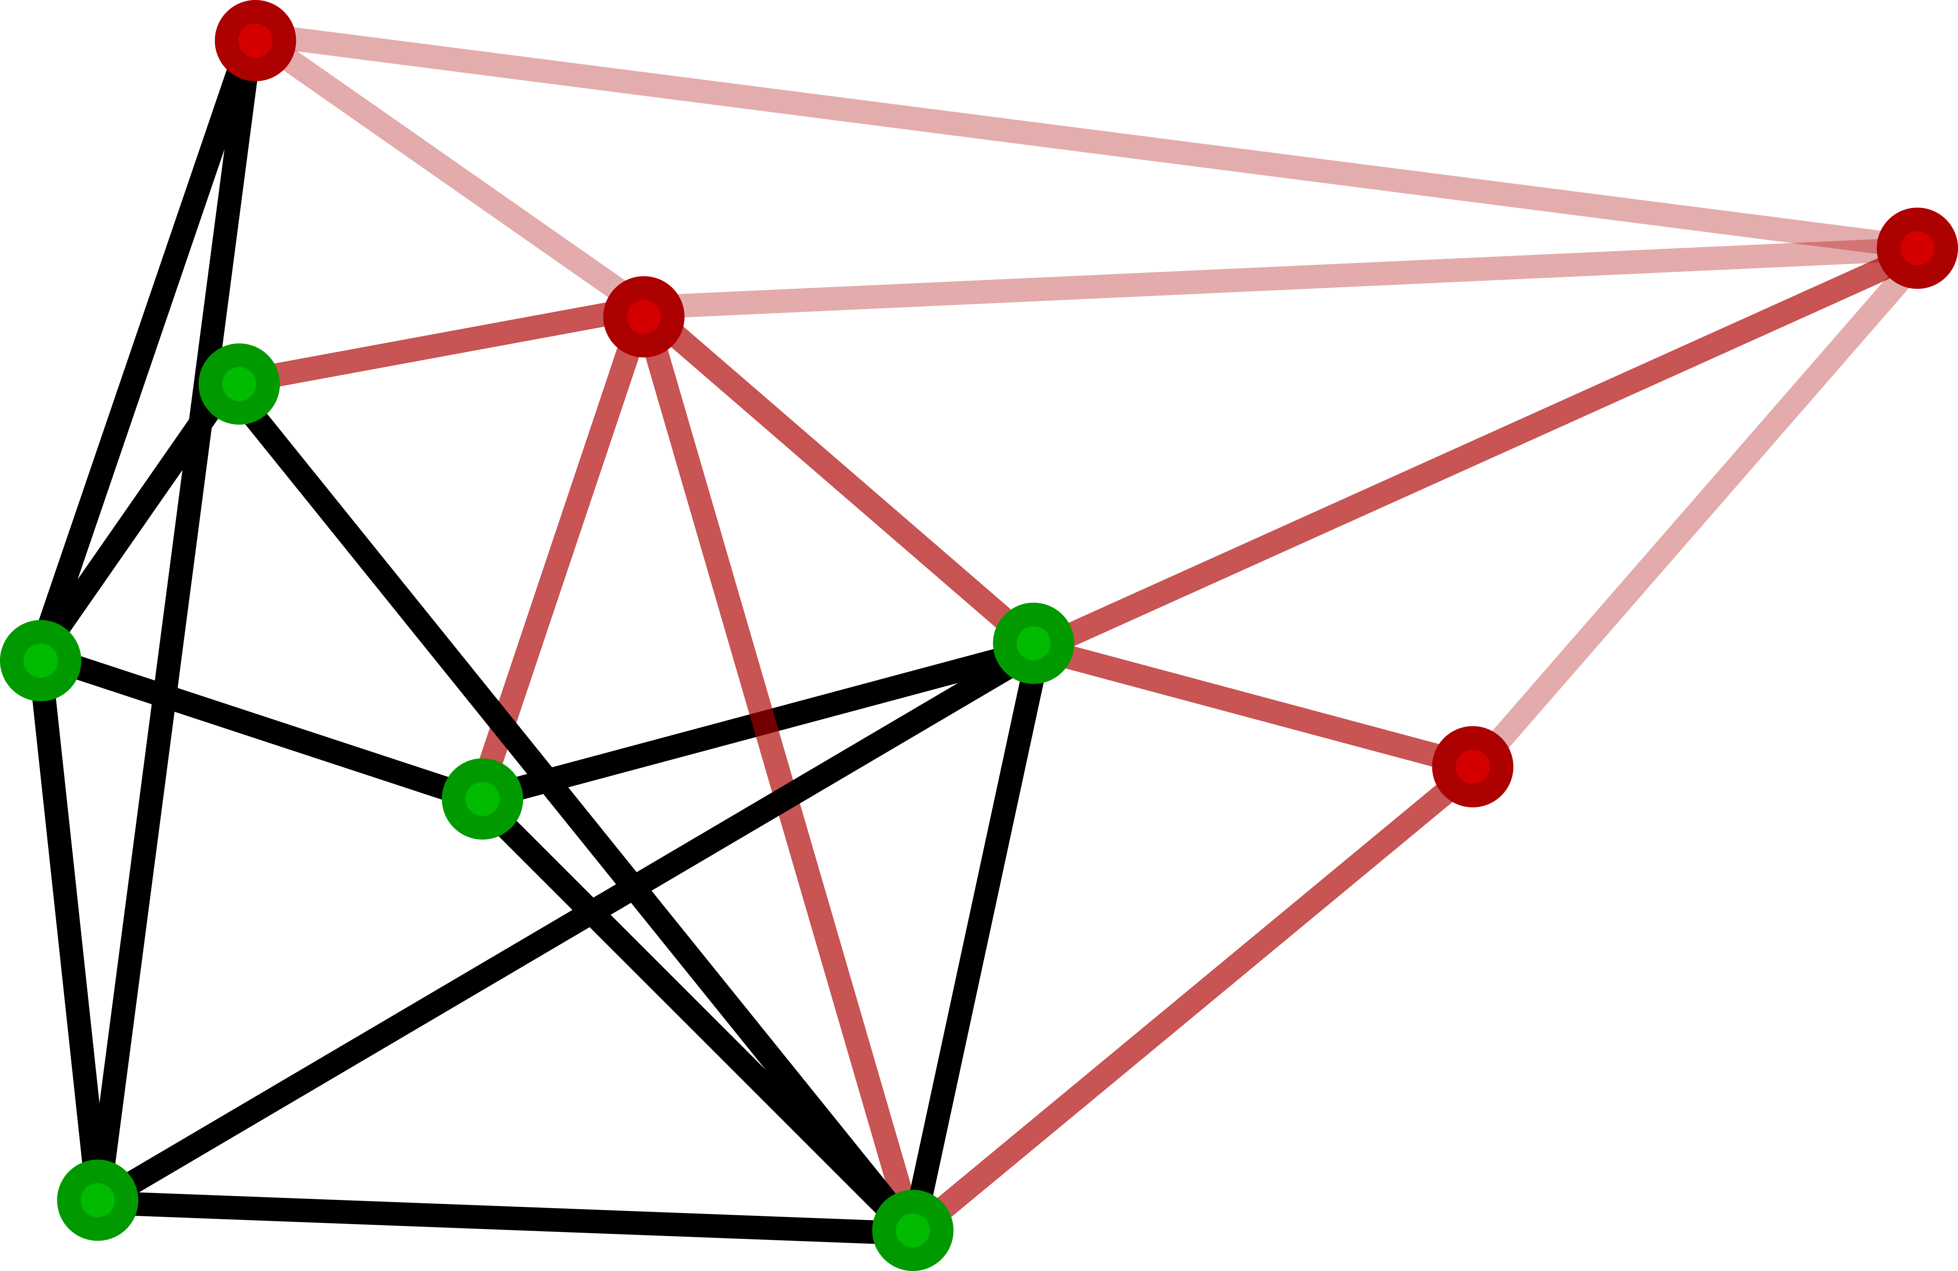
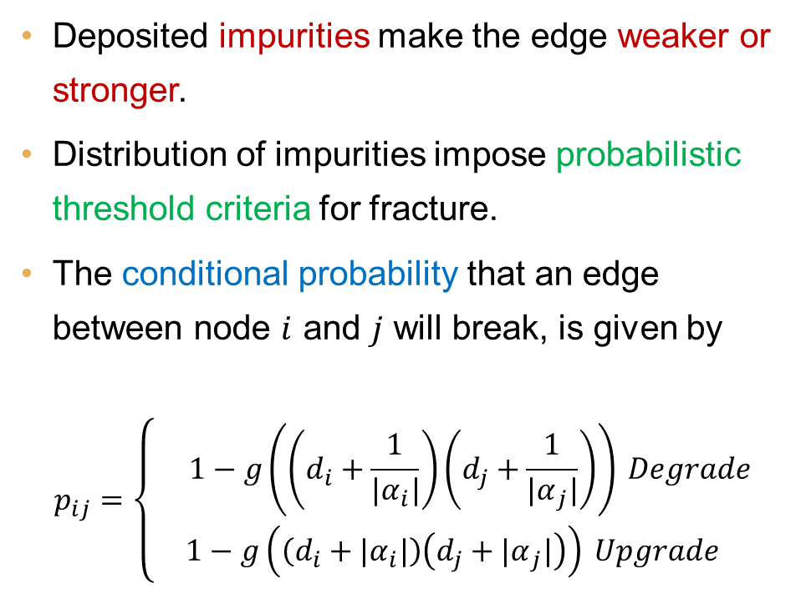
Random graph-based impurity maps
Impurity maps
Deposited impurities make the edge weaker or stronger.
Distribution of impurities impose probabilistic threshold criteria for fracture.
The conditional probability that an edge between node $i$ and $j$ will break, is given by
$$p_{ij}=\left\{\begin{aligned} 1−g\left(\left(d_{i}+\frac{1}{{|α}_{i}|}\right)\left(d_{j}+\frac{1}{{|α}_{j}|}\right)\right) Degrade \\ 1−g\left(\left(d_{i}+{|α}_{i}|\right)\left(d_{j}+{|α}_{j}|\right)\right) Upgrade\end{aligned}\right.$$

Slide 14
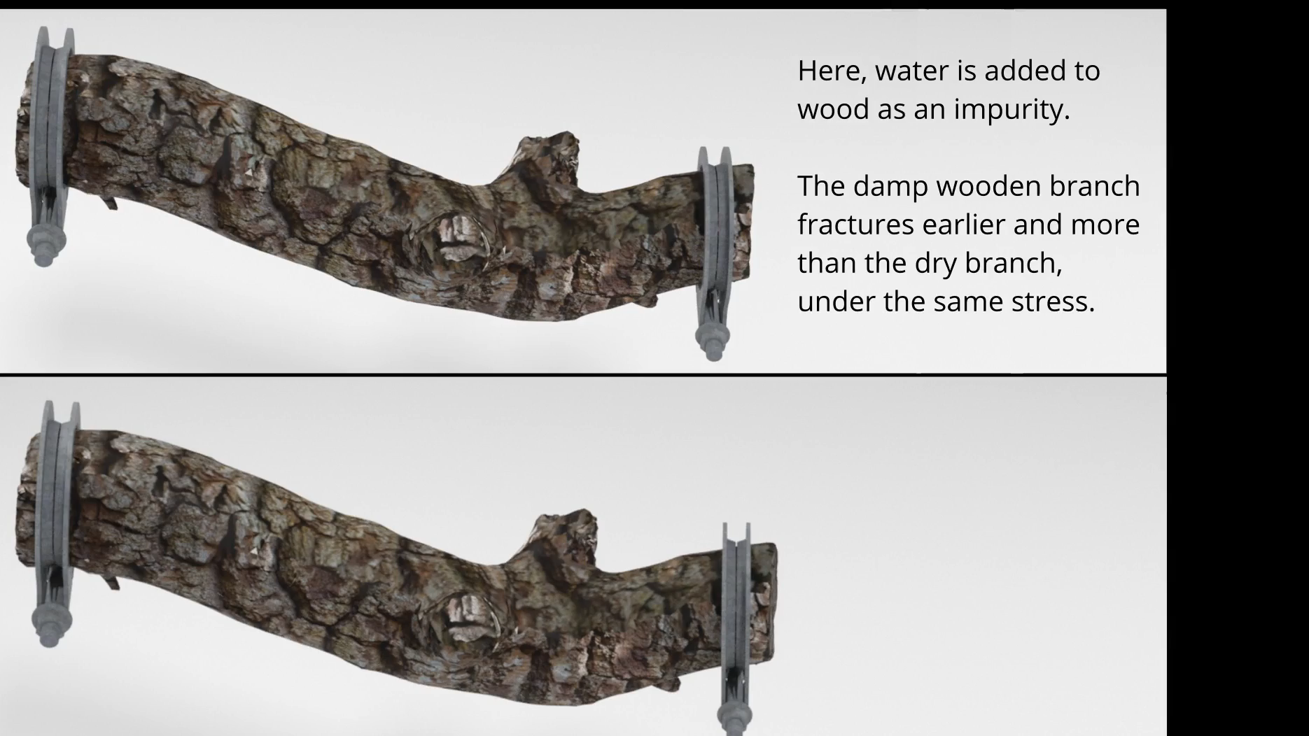
dry and wet wood

Slide 15
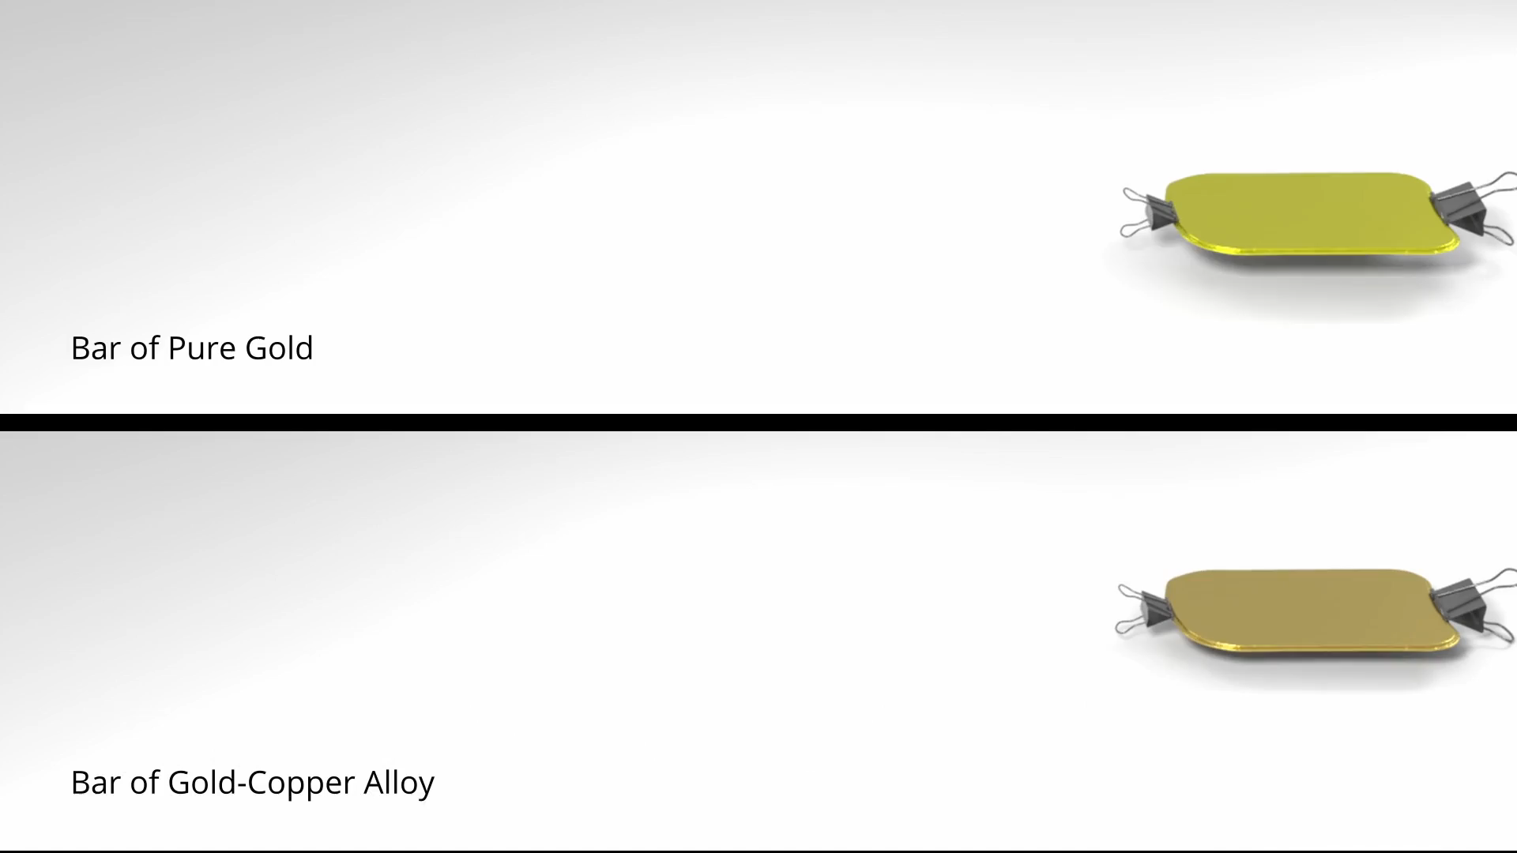
Pure and impure gold

Slide 16
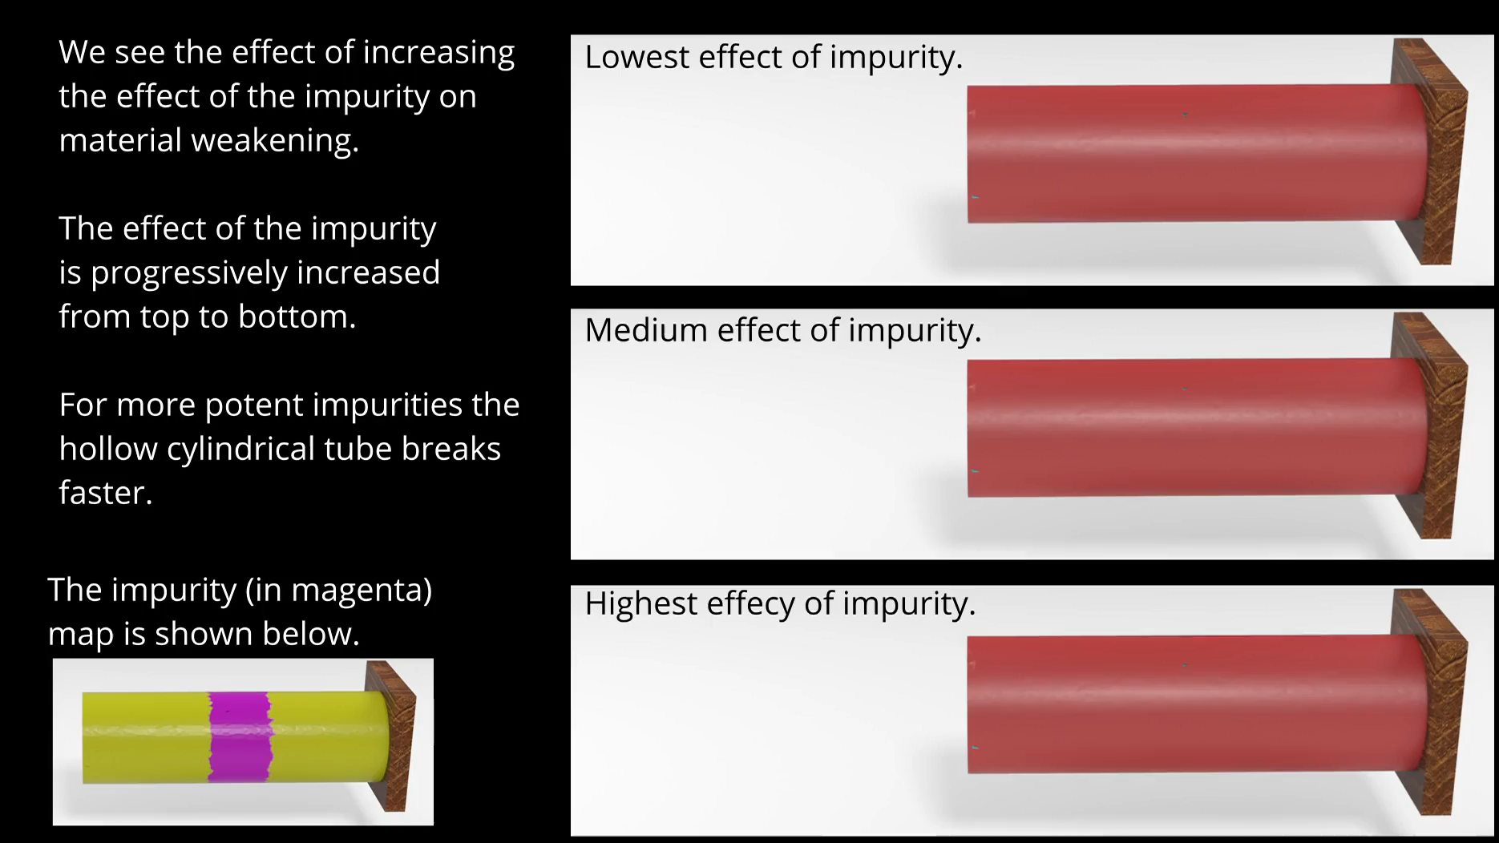
Effect of potency of material impurity

Slide 17
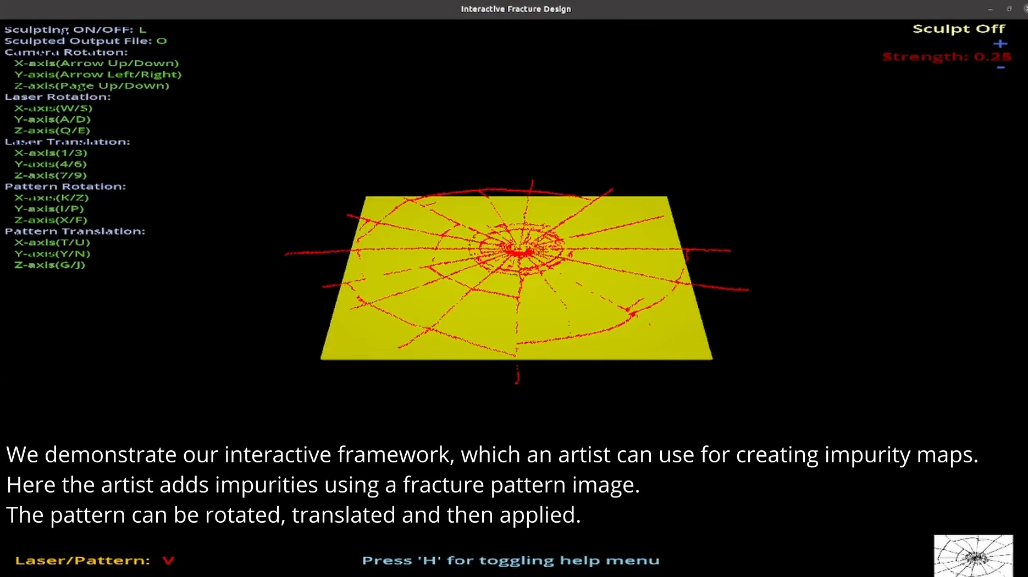
Interactive interface for artist controlled fracture

Slide 18
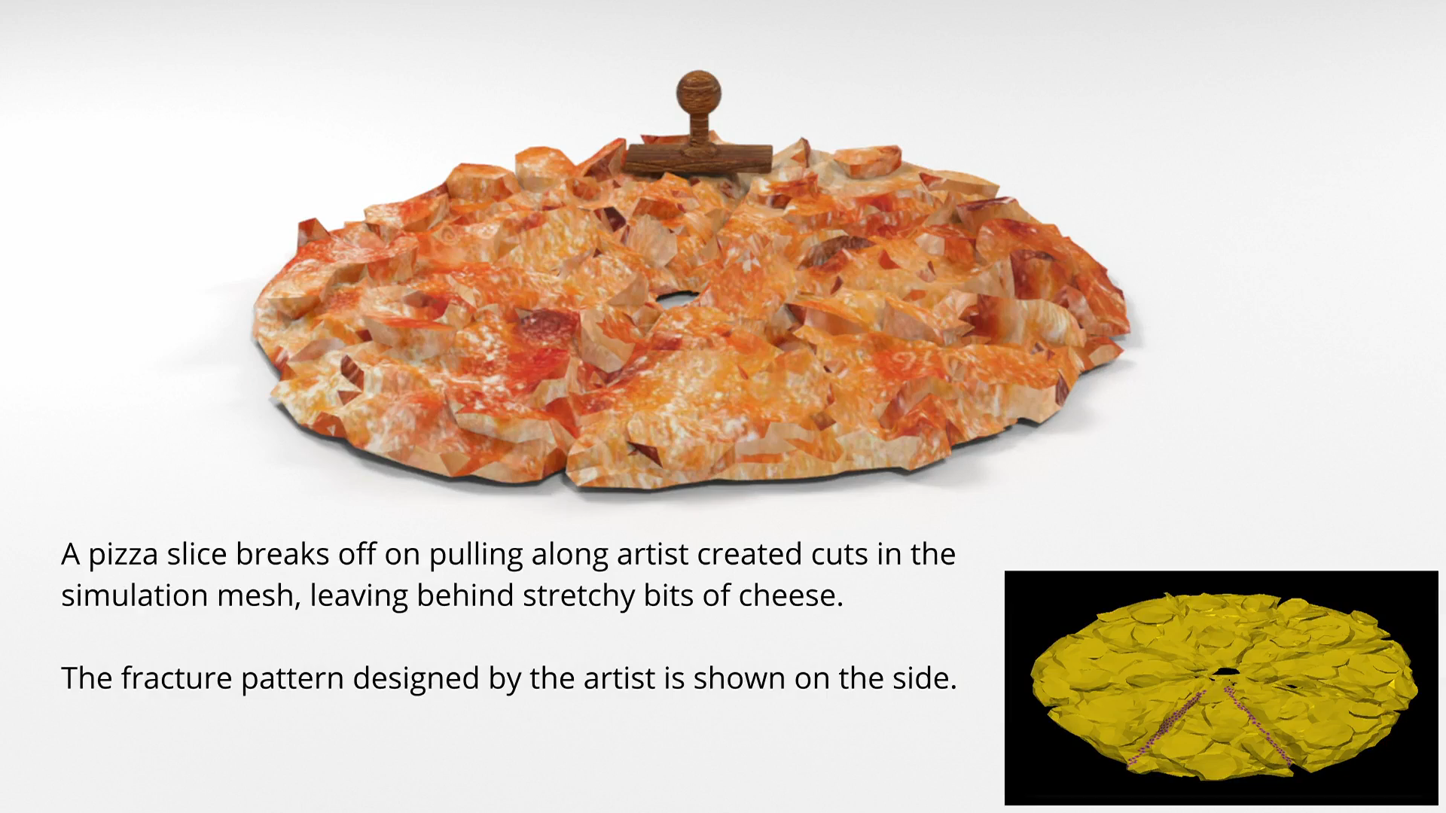
Slicing pizza

Slide 19
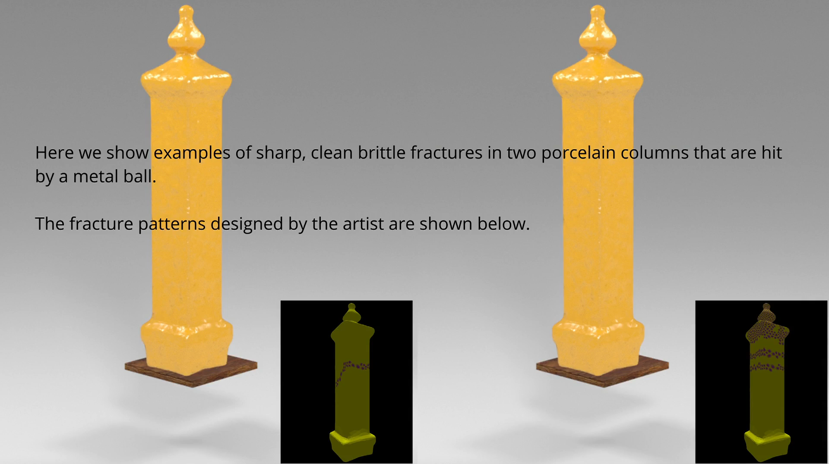
Brittle column fracture

Slide 20
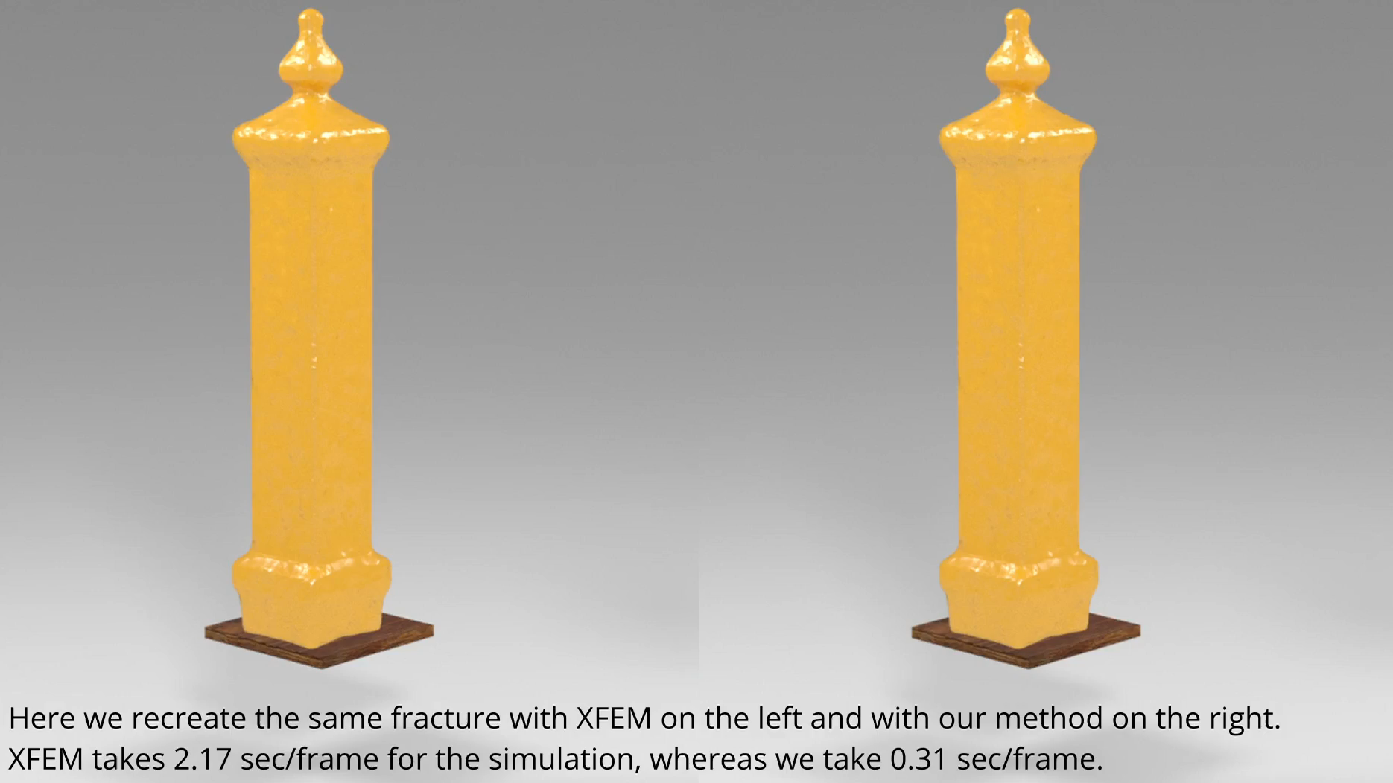
Our method vs XFEM
XFEM
XFEM adds extra degrees of freedom with each new cut.
System matrix size increases.
Simulation gets slower.
Our method
System matrix size remains constant throughout the simulation.
Simulation time is comparable with normal FEM.

Slide 21
Conclusion
Discussion
Simulated anisotropic fracture using Graph-based FEM.
Developed a random graph-based framework to model the effect of impurity on fracture.
Designed an interactive framework to simulate artist directed fracture patterns.
Future Work
Explore longer-term fracture phenomena like failure due fatigue.

Slide 22
Thank you
Project Page: https://avirupmandal.github.io/randomgraph-mig22/
Contact: avirupmandal@ee.iitb.ac.in

